Slide 2
Objectives
Define and describe transactions
Explain the procedure to implement transactions
Explain the process of controlling transactions
Explain the steps to mark a transaction
Distinguish between implicit and explicit transactions
Explain isolation levels
Explain the scope and different types of locks
Explain transaction management

Slide 3
Introduction
A transaction is
a single unit of work.
is successful only when all data modifications that are made in a transaction are committed and are saved in the database permanently.
If the transaction is rolled back or cancelled, then it means that the transaction has encountered errors and there are no changes made to the contents of the database.
A transaction can be either committed or rolled back.

Slide 4
Need for Transactions 1-5
There are many circumstances where the users need to make many changes to the data in more than one database tables.
In many cases, the data will be inconsistent that executes the individual commands.
Suppose if the first statement executes correctly but the other statements fail then the data remains in an incorrect state.
A good scenario will be the funds transfer activity in a banking system which will need an INSERT and two UPDATE statements.

Slide 5
Need for Transactions 2-5
First, the user has to increase the balance of the destination account and then, decrease the balance of the source account.
The user has to check that the transactions are committed and whether the same changes are made to the source account and the destination account.

Slide 6
Need for Transactions 3-5
Defining Transactions: A logical unit of work must exhibit four properties, called the atomicity, consistency, isolation, and durability (ACID) properties, to qualify as a transaction.
Atomicity: If the transaction has many operations then all should be committed.
Consistency: The sequence of operations must be consistent.
Isolation: The operations that are performed must be isolated from the other operations on the same server or on the same database.
Durability: The operations that are performed on the database must be saved and stored in the database permanently.

Slide 7
Need for Transactions 4-5
Implementing Transactions: SQL Server supports transactions in several modes.
Autocommit Transactions: Every single-line statement is automatically committed as soon as it completes.
Explicit Transactions: Every transaction explicitly starts with the BEGIN TRANSACTION statement and ends with a ROLLBACK or COMMIT transaction.
Implicit Transactions: A new transaction is automatically started when the earlier transaction completes and every transaction is explicitly completed by using the ROLLBACK or COMMIT statement.
Batch-scoped Transactions: These transactions are related to Multiple Active Result Sets (MARS).

Slide 8
Need for Transactions 5-5
Transactions Extending Batches
Transaction statements identify the block of code that should either fail or succeed and provide the facility where the database engine can undo or roll back the operations.
Users can add code to identify the batch as a transaction and place the batch between the BEGIN TRANSACTION and COMMIT TRANSACTION.
Users can add error-handling code to roll back the transaction in case of errors. The error-handling code will undo the partial changes that were made before the error had occurred.

Slide 9
Controlling Transactions
Transactions can be controlled through applications by specifying the beginning and ending of a transaction.
This is done by using the database API functions or Transact-SQL statements.
When a transaction is started on a connection, all Transact-SQL statements are executed on the same connection and are a part of the connection until the transaction ends.
Transactions are managed at the connection level.

Slide 10
Starting and Ending Sessions using Transact-SQL 1-11
One of the ways users can start and end transactions is by using Transact-SQL statements.
Users can start a transaction in SQL Server in the implicit or explicit modes.
Explicit transaction mode starts a transaction by using a BEGIN TRANSACTION statement.
Users can end a transaction using the ROLLBACK or COMMIT statements.

Slide 11
Starting and Ending Sessions using Transact-SQL 2-11
BEGIN TRANSACTION statement marks the beginning point of an explicit or local transaction.
Syntax:
BEGIN { TRAN | TRANSACTION }
[ { transaction_name | @tran_name_variable }
[ WITH MARK [ 'description' ] ]
]
[ ; ]
where,
transaction_name: specifies the name that is assigned to the transaction. It should follow the rules for identifiers and limit the identifiers that are 32 characters long.
@tran_name_variable: specifies the name of a user-defined variable that contains a valid transaction name.
WITH MARK['description']: specifies the transaction that is marked in the log. The description string defines the mark.

Slide 12
Starting and Ending Sessions using Transact-SQL 3-11
Following code snippet shows how to create and begin a transaction:
USE AdventureWorks2012;
GO
DECLARE @TranName VARCHAR(30);
SELECT @TranName = 'FirstTransaction';
BEGIN TRANSACTION @TranName;
DELETE FROM HumanResources.JobCandidate
WHERE JobCandidateID = 13;

Slide 13
Starting and Ending Sessions using Transact-SQL 4-11
COMMIT TRANSACTION statement marks an end of a successful implicit or explicit transaction.
Syntax:
COMMIT { TRAN | TRANSACTION } [ transaction_name | @tran_name_variable ] ]
[ ; ]
where,
transaction_name: specifies the name that is assigned by the previous BEGIN TRANSACTION statement. It should follow the rules for identifiers and do not allow identifiers that are 32 characters long.
@tran_name_variable: specifies the name of a user-defined variable that contains a valid transaction name. The variable can be declared as char, varchar, nchar, or nvarchar data type. If more than 32 characters are passed to the variable, then only 32 characters are used and the remaining characters will be truncated.

Slide 14
Starting and Ending Sessions using Transact-SQL 5-11
Following code snippet shows how to commit a transaction:
BEGIN TRANSACTION;
GO
DELETE FROM HumanResources.JobCandidate
WHERE JobCandidateID = 11;
GO
COMMIT TRANSACTION;
GO
COMMIT WORK statement marks the end of a transaction.
Syntax:
COMMIT [ WORK ]
[ ; ]
COMMIT TRANSACTION and COMMIT WORK are identical except for the fact that COMMIT TRANSACTION accepts a user-defined transaction name.

Slide 15
Starting and Ending Sessions using Transact-SQL 6-11
Marking a Transaction
Following code snippet shows how to mark a transaction:
BEGIN TRANSACTION DeleteCandidate
WITH MARK N'Deleting a Job Candidate';
GO
DELETE FROM HumanResources.JobCandidate
WHERE JobCandidateID = 11;
GO
COMMIT TRANSACTION DeleteCandidate;
ROLLBACK TRANSACTION - This transaction rolls back or cancels an implicit or explicit transaction to the starting point of the transaction, or to a savepoint in a transaction.
Syntax:
COMMIT [ WORK ]
[ ; ]

Slide 16
Starting and Ending Sessions using Transact-SQL 7-11
ROLLBACK TRANSACTION - This transaction rolls back or cancels an implicit or explicit transaction to the starting point of the transaction, or to a savepoint in a transaction.
Syntax:
ROLLBACK { TRAN | TRANSACTION }
[ transaction_name | @tran_name_variable
| savepoint_name | @savepoint_variable ]
[ ; ]
where,
transaction_name: specifies the name that is assigned to the BEGIN TRANSACTION statement. It should confirm the rules for identifiers.
@tran_name_variable: specifies the name of a user-defined variable that contains a valid transaction name. The variable can be declared as char, varchar, nchar, or nvarchar data type.
savepoint_name: specifies the savepoint_name from a SAVE TRANSACTION statement. Use savepoint_name only when a conditional rollback affects a part of a transaction.
@savepoint_variable: specifies the name of savepoint variable that contain a valid savepoint name. The variable can be declared as char, varchar, nchar, or nvarchar data type.

Slide 17
Starting and Ending Sessions using Transact-SQL 8-11
Following code snippet demonstrates the use of ROLLBACK:
USE Sterling;
GO
CREATE TABLE ValueTable ([value] char)
GO
Following code snippet shows a transaction that inserts two records into ValueTable:
BEGIN TRANSACTION
INSERT INTO ValueTable VALUES('A');
INSERT INTO ValueTable VALUES('B');
GO
ROLLBACK TRANSACTION
INSERT INTO ValueTable VALUES('C');
SELECT [value] FROM ValueTable;
Then, it rolls back the transaction and again inserts one record into ValueTable.

Slide 18
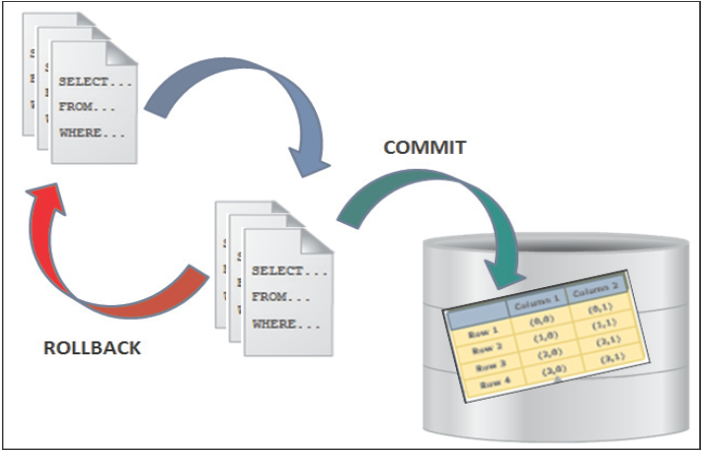
Starting and Ending Sessions using Transact-SQL 9-11
ROLLBACK WORK statement rolls back a user-specified transaction to the beginning of the transaction.
Syntax:
ROLLBACK [ WORK ]
[ ; ]

Slide 19
Starting and Ending Sessions using Transact-SQL 10-11
SAVE TRANSACTION statement sets a savepoint within a transaction.
Syntax:
SAVE { TRAN | TRANSACTION } { savepoint_name | @savepoint_variable }
[ ; ]
where,
savepoint_name: specifies the savepoint_name assigned. These names conform to the rules of identifiers and are restricted to 32 characters.
@savepoint_variable: specifies the name of a user-defined variable that contain a valid savepoint name. The variable can be declared as char, varchar, nchar, or nvarchar data type. More than 32 characters are allowed to pass to the variables but only the first 32 characters are used.

Slide 20
Starting and Ending Sessions using Transact-SQL 11-11
Following code snippet demonstrates how to use a savepoint transaction:
CREATE PROCEDURE SaveTranExample
@InputCandidateID INT
AS
DECLARE @TranCounter INT;
SET @TranCounter = @@TRANCOUNT;
IF @TranCounter > 0
SAVE TRANSACTION ProcedureSave;
ELSE
BEGIN TRANSACTION;
DELETE HumanResources.JobCandidate
WHERE JobCandidateID = @InputCandidateID;
IF @TranCounter = 0
COMMIT TRANSACTION;
IF @TranCounter = 1
ROLLBACK TRANSACTION ProcedureSave;
GO

Slide 21
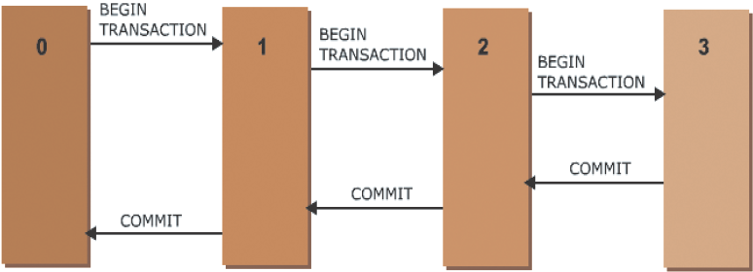
@@TRANCOUNT 1-2
@@TRANCOUNT system function returns a number of BEGIN TRANSACTION statements that occur in the current connection.
Syntax:
@@TRANCOUNT

Slide 22
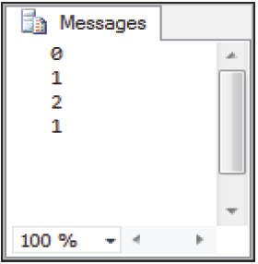
@@TRANCOUNT 2-2
Following code snippet shows the effect that nested BEGIN and COMMIT statements have on the @@TRANCOUNT variable:
PRINT @@TRANCOUNT
BEGIN TRAN
PRINT @@TRANCOUNT
BEGIN TRAN
PRINT @@TRANCOUNT
COMMIT
PRINT @@TRANCOUNT
COMMIT
PRINT @@TRANCOUNT
Output:

Slide 23
Marking a Transaction 1-3
Users can use transaction marks to recover the related updates made to two or more related databases.
Marking a transaction is useful only when the user is willing to lose recently committed transactions or is testing related databases.
Marking related transactions on a routine basis in every single related database creates a sequence of common recovery points in a database.
The transaction marks are incorporated in log backups and are also recorded in the transaction log.
In case of any disaster, user can restore each of the databases to the same transaction mark in order to recover them to a consistent point.

Slide 24
Marking a Transaction 2-3
As the transaction mark consume log space, use them only for transactions that play an important role in the database recovery strategy.
Concerns for Using Marked Transactions
When the marked transaction is committed, then a row is inserted in the logmarkhistory table in msdb.
If a marked transaction spans over multiple databases on different servers or on the same database server, the marks must be logged in the records of all affected databases.

Slide 25
Marking a Transaction 3-3
For creating a marked transaction in a set of databases, the steps to be followed are as follows:
Name the transaction in the BEGIN TRANSACTION statement and use the WITH MARK clause
Execute an update against all of the databases in the set
Following code snippet demonstrates for creating a marked transaction in a set of databases:
USE AdventureWorks2012
GO
BEGIN TRANSACTION ListPriceUpdate
WITH MARK 'UPDATE Product list prices';
GO
UPDATE Production.Product
SET ListPrice = ListPrice * 1.20
WHERE ProductNumber LIKE 'BK-%';
GO
COMMIT TRANSACTION ListPriceUpdate;
GO

Slide 26
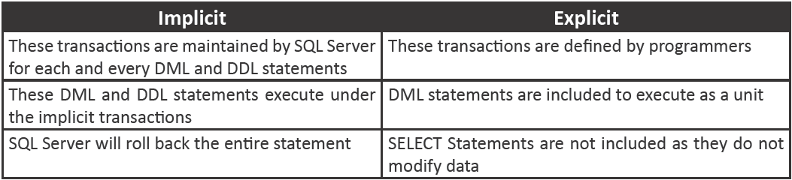
Difference Between Implicit and Explicit Transaction
Following table lists the differences between implicit and explicit transactions:

Slide 27
Isolation Levels 1-2
Transactions identify the isolation levels that define the degree to which one transaction must be isolated from the data modifications or resource that are made by the other transactions.
Isolation levels are defined in terms of which the concurrency side effects such as dirty reads are allowed.
When one transaction changes a value and a second transaction reads the same value before the original change has been committed or rolled back, it is called as a dirty read.
A transaction acquires an exclusive lock every time on each data that it modifies and it holds that lock until the transaction is completed, irrespective of the isolation level that is set for that transaction.
A lower isolation level increases the capability of several users to access data at the same time. A higher isolation level decreases the types of concurrency effects which user may encounter.

Slide 28
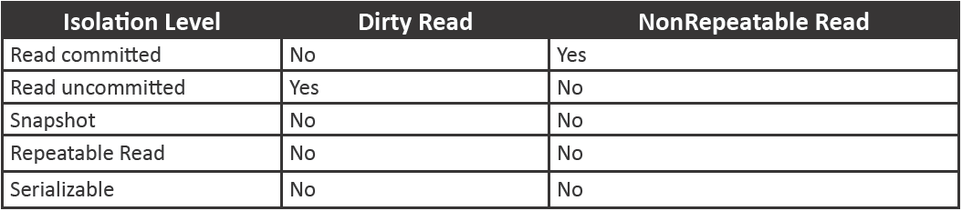
Isolation Levels 2-2
Following table lists the concurrency effects that are allowed by the different isolation levels:

Slide 29
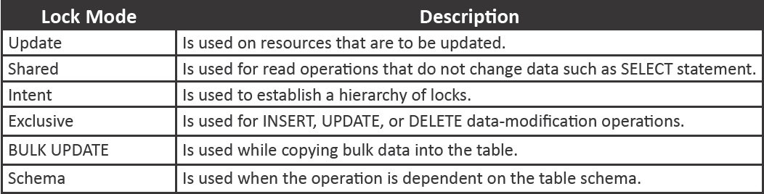
Scope and Different Types of Locks 1-6
SQL Server Database Engine locks the resources that use different lock modes, which determine the resources that are accessible to concurrent transactions.
Following table lists the lock modes used by the Database Engine:

Slide 30
Scope and Different Types of Locks 2-6
Update Locks
Shared Locks
avoid common forms of deadlock
allow parallel transactions to read a resource under pessimistic concurrency control
When two transactions acquire a shared lock on a resource and try to update data simultaneously, the same transaction attempts the lock conversion to an exclusive lock
Only one transaction can obtain an update lock to a resource at a time
When a transaction modifies a resource, then the update lock is converted to an exclusive lock
Transactions can change the data while shared locks exist on the resource
Shared locks are released on a resource once the read operation is completed

Slide 31
Scope and Different Types of Locks 3-6
Exclusive Locks
Intent Locks
prevent access to resources by concurrent transactions
used for protecting and places an exclusive or shared lock on the resource that is at a lower level in the lock hierarchy
no other transaction can change data and read operations take place only through the read uncommitted isolation level or NOLOCK hint
DML statements usually request both exclusive and shared locks
When a transaction modifies a resource, then the update lock is converted to an exclusive lock
are acquired before a lock at the low level and hence, indicate intent to place locks at low level
useful for two purposes:
prevent other transactions from changing the higher-level resource
improve the efficiency of the Database Engine for identifying the lock conflicts

Slide 32
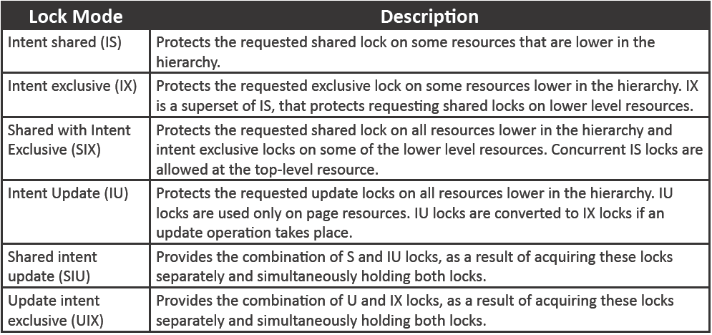
Scope and Different Types of Locks 4-6
Setting the intent lock at the table level protects other transaction from subsequently acquiring an exclusive lock on the table containing pages.
Following table lists the lock modes in Intent locks:

Slide 33
Scope and Different Types of Locks 5-6
Many persons are involved in the design, use, and maintenance of a large database with a few hundred users.
Bulk Update Locks
Schema Locks
are used by the database engine
are used by Database Engine while performing a table DDL operation such as dropping a table or a column
are used when a large amount of data is copied into a table (bulk copy operations) and either the table lock on bulk load option is set or the TABLOCK hint is specified using the sp_table option
allow multiple threads to load bulk data continuously in the same table
prevents concurrent access to the table, which means a schema lock blocks all external operations until the lock releases
are used by the database engine while compiling and executing the queries

Slide 34
Scope and Different Types of Locks 6-6
Key-Range Locks
protect a collection of rows that are implicitly present in a recordset which is being read by a Transact-SQL statement while using the serializable transaction isolation level
prevent the phantom deletions or insertions in the recordset that accesses a transaction

Slide 35
Transaction Management
Every single statement that is executed is, by default, transactional in SQL Server.
If a single SQL statement is issued, then, an implicit transaction is started.
When the users use explicit BEGIN TRAN/COMMIT TRAN commands, they can group them together as an explicit transaction.
SQL Server implements several transaction isolation levels that ensure the ACID properties of these transactions.
However, data stored in this form is not permanent. Records in such manual files can only be maintained for a few months or few years.

Slide 36
Transaction Log 1-3
SQL Server database has a transaction log, which records all transactions and the database modifications made by every transaction.
Transaction log should be truncated regularly to keep it from filling up.
Operations supported by the transaction log are as follows:
Individual transactions recovery
Incomplete transactions recovery when SQL Server starts
Transactional replication support
Disaster recovery solutions and high availability support
Roll back a file, restored database, filegroup, or page forward to the point of failure

Slide 37
Transaction Log 2-3
Truncating a Transaction Log
Truncating a log frees the space in the log file for reusing the transaction log.
Truncation of logs starts automatically after the following events:
In a simple recovery model after the checkpoint
In a bulk-logged recovery model or full recovery model, if the checkpoint is occurred ever since the last backup, truncation occurs after a log backup

Slide 38
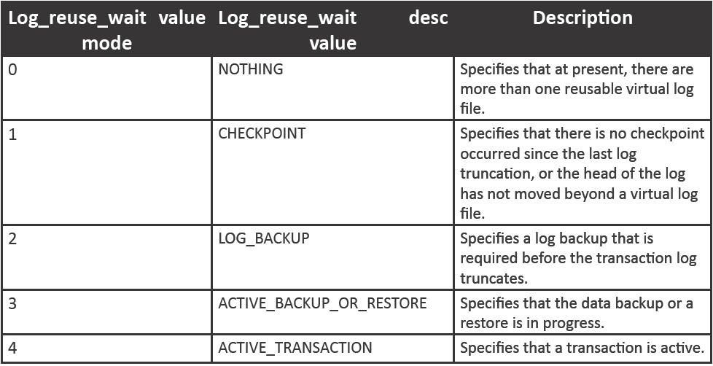
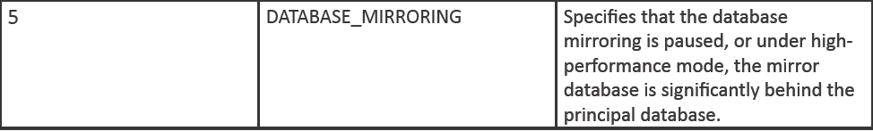
Transaction Log 3-3
Log truncations are delayed due to many reasons. Users can also discover if anything prevents the log truncation by querying the log_reuse_wait_desc and log_reuse_wait columns of the sys.databases catalog view.
Following table lists the values of some of these columns:

Slide 39
Summary
A transaction is a sequence of operations that works as a single unit.
Transactions can be controlled by an application by specifying a beginning and an ending.
BEGIN TRANSACTION marks the beginning point of an explicit or local transaction.
COMMIT TRANSACTION marks an end of a successful implicit or explicit transaction.
ROLLBACK with an optional keyword WORK rolls back a user-specified transaction to the beginning of the transaction.
@@TRANCOUNT is a system function that returns a number of BEGIN TRANSACTION statements that occur in the current connection.
Isolation levels are provided by the transaction to describe the extent to which a single transaction needs to be isolated from changes made by other transactions.
The SQL Server Database Engine locks the resources using different lock modes, which determine the resources that are accessible to concurrent transactions.

